Slide 1



SEJONG UNIVERSITY
STUDENT EXCHANGE WEBPAGE
For students, teachers, and staff
GROUP 3

Slide 2

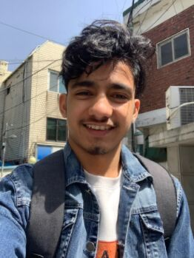
MEET THE DEV TEAM
NG. HONG PHUC
LEADER
GAUTAM BOHARA
TEAM MEMBER

Slide 3


PRESENTATION DETAILS
What we have done
Features & Explanation
Future Improvements
Q&A

Slide 4


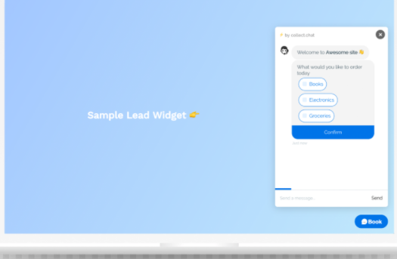
What we have done
NAVIGATION
ANIMATION
CHATBOT
Add more pages
Enhance User Interface Design & User Experience by adding animation
Increase interaction between users and page.

Slide 5
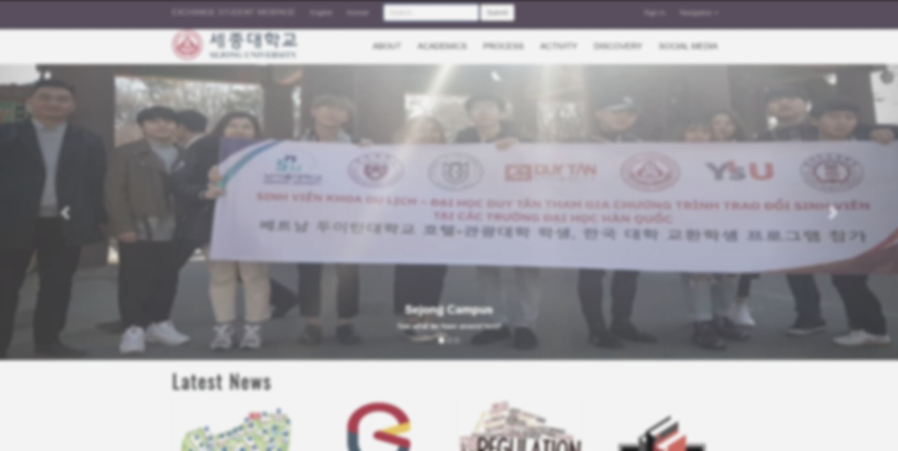
Explanation

Slide 6
Link: https://nguyenhongphuc3007.github.io/SJExchangeWebpage/

Slide 7
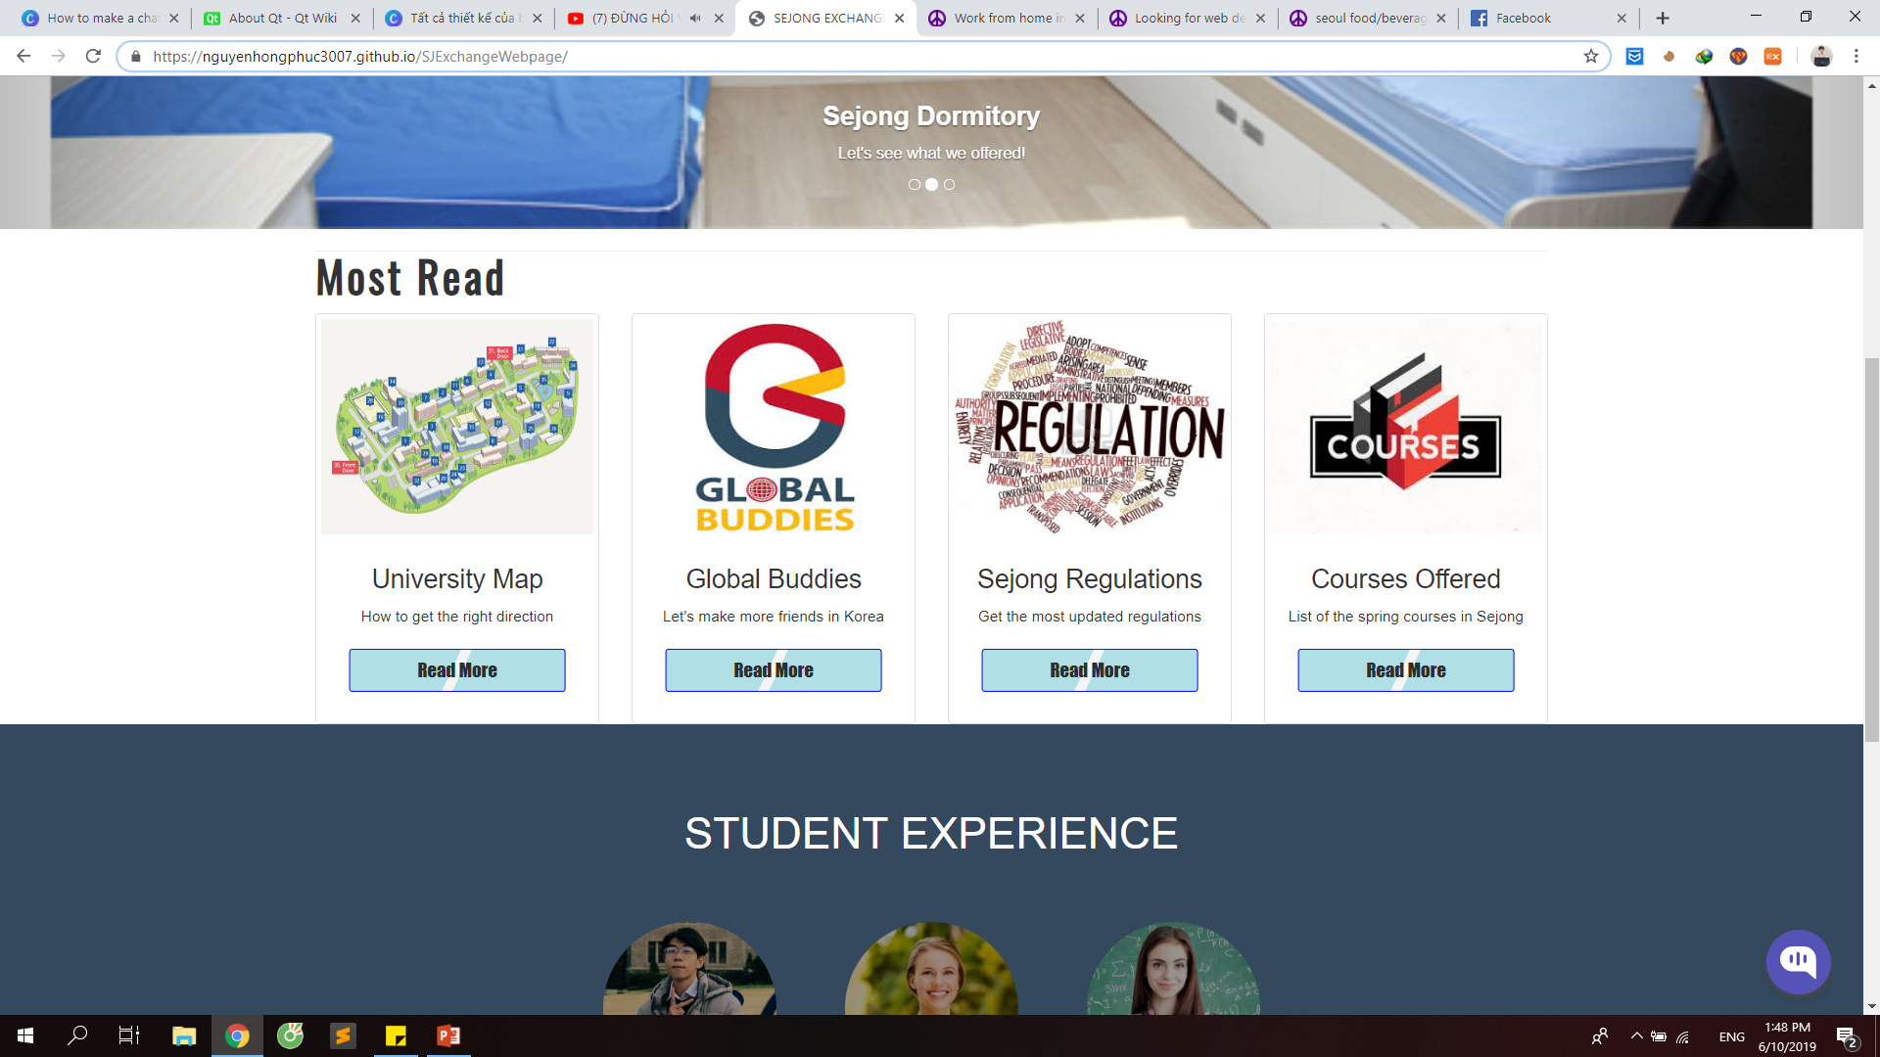
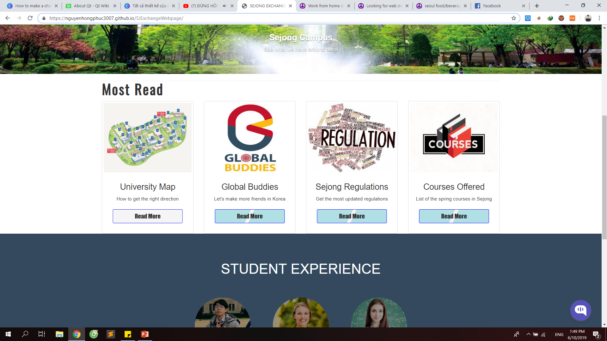
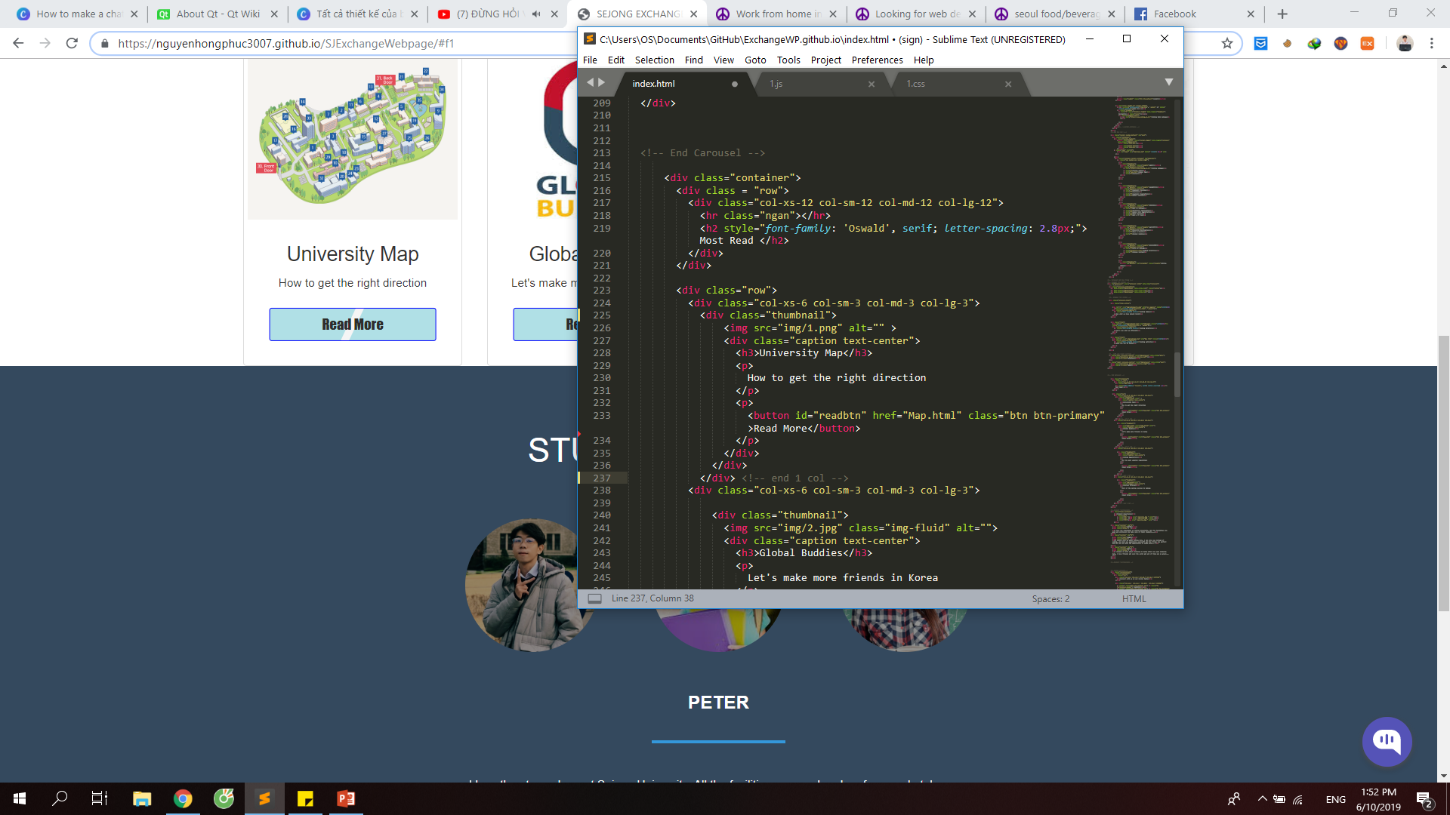
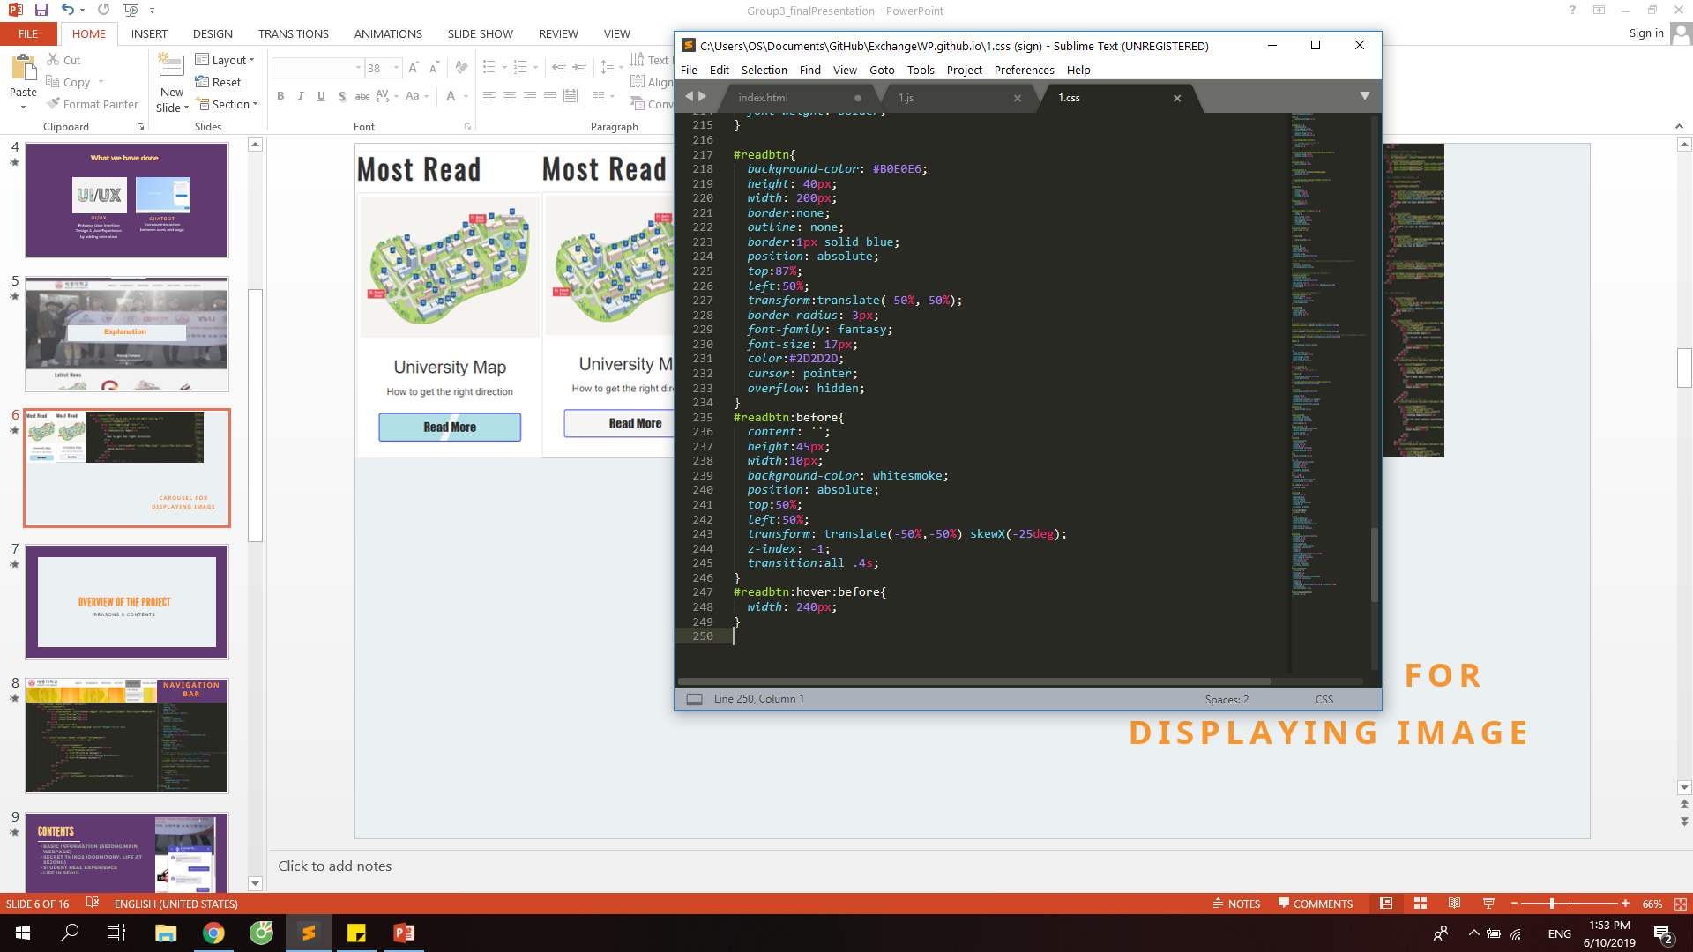
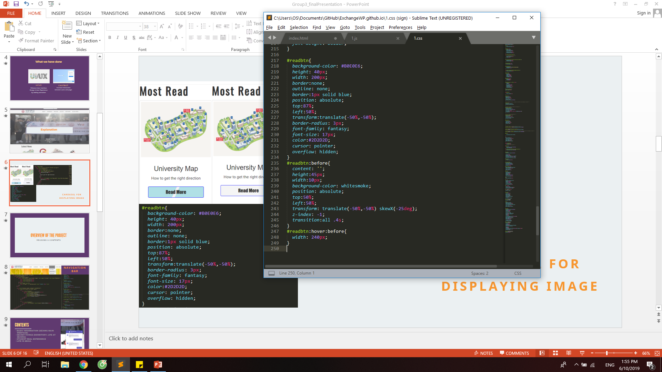
ADD ANIMATION TO AN ELEMENT

Slide 8


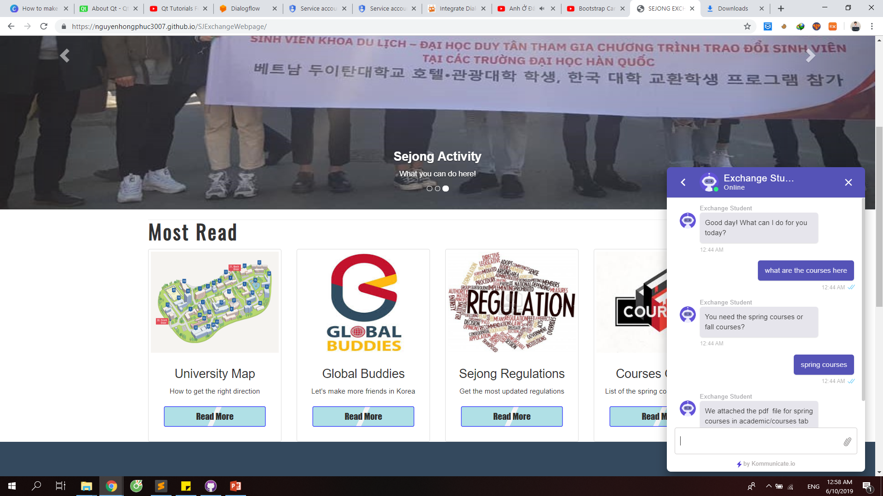
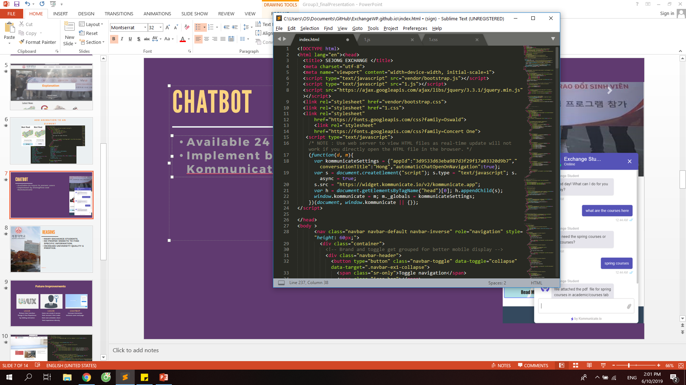
CHATBOT
Available 24 hours to answer users
Implement by Dialogflow and Kommunicate
Can be placed into the website directly via HTML and JS code.

Slide 9
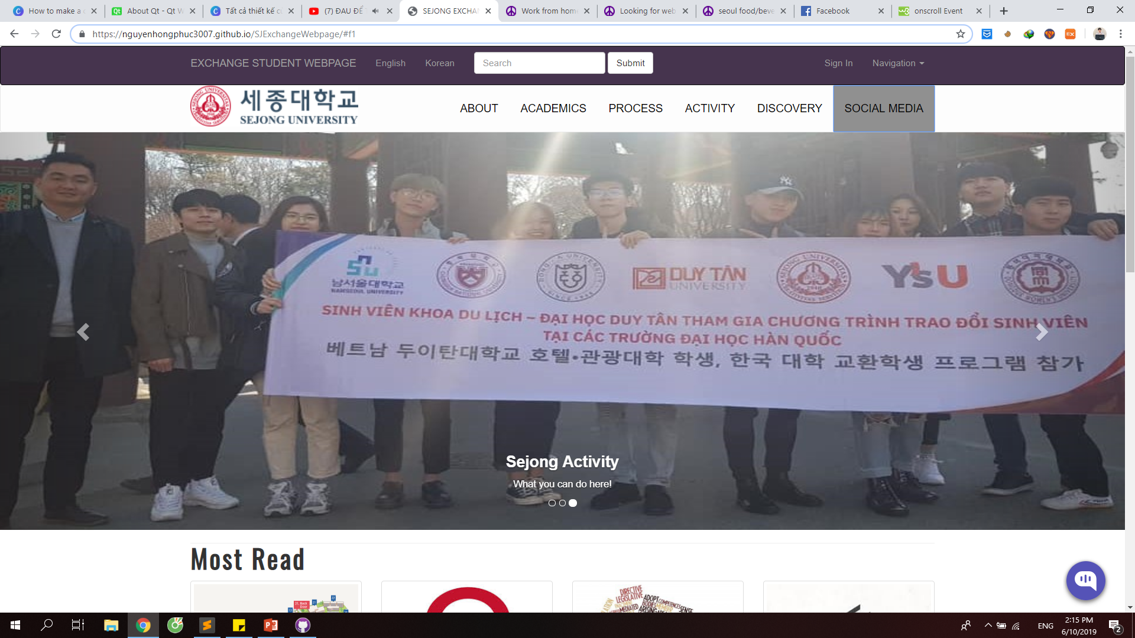
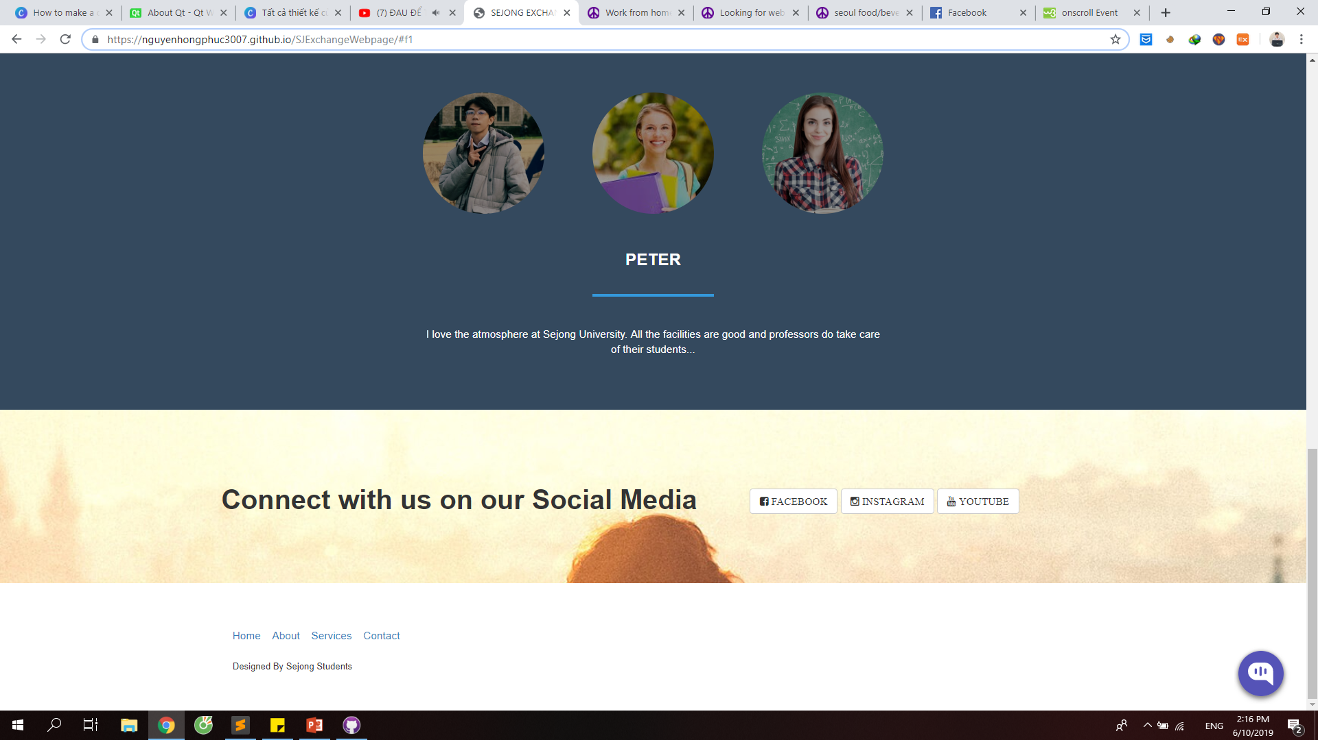
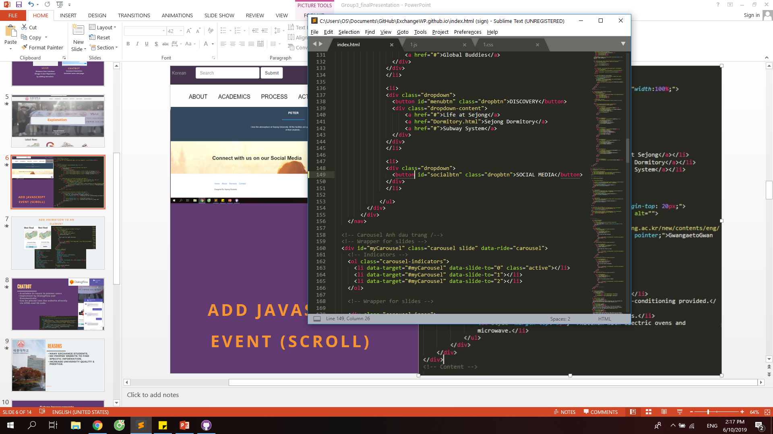
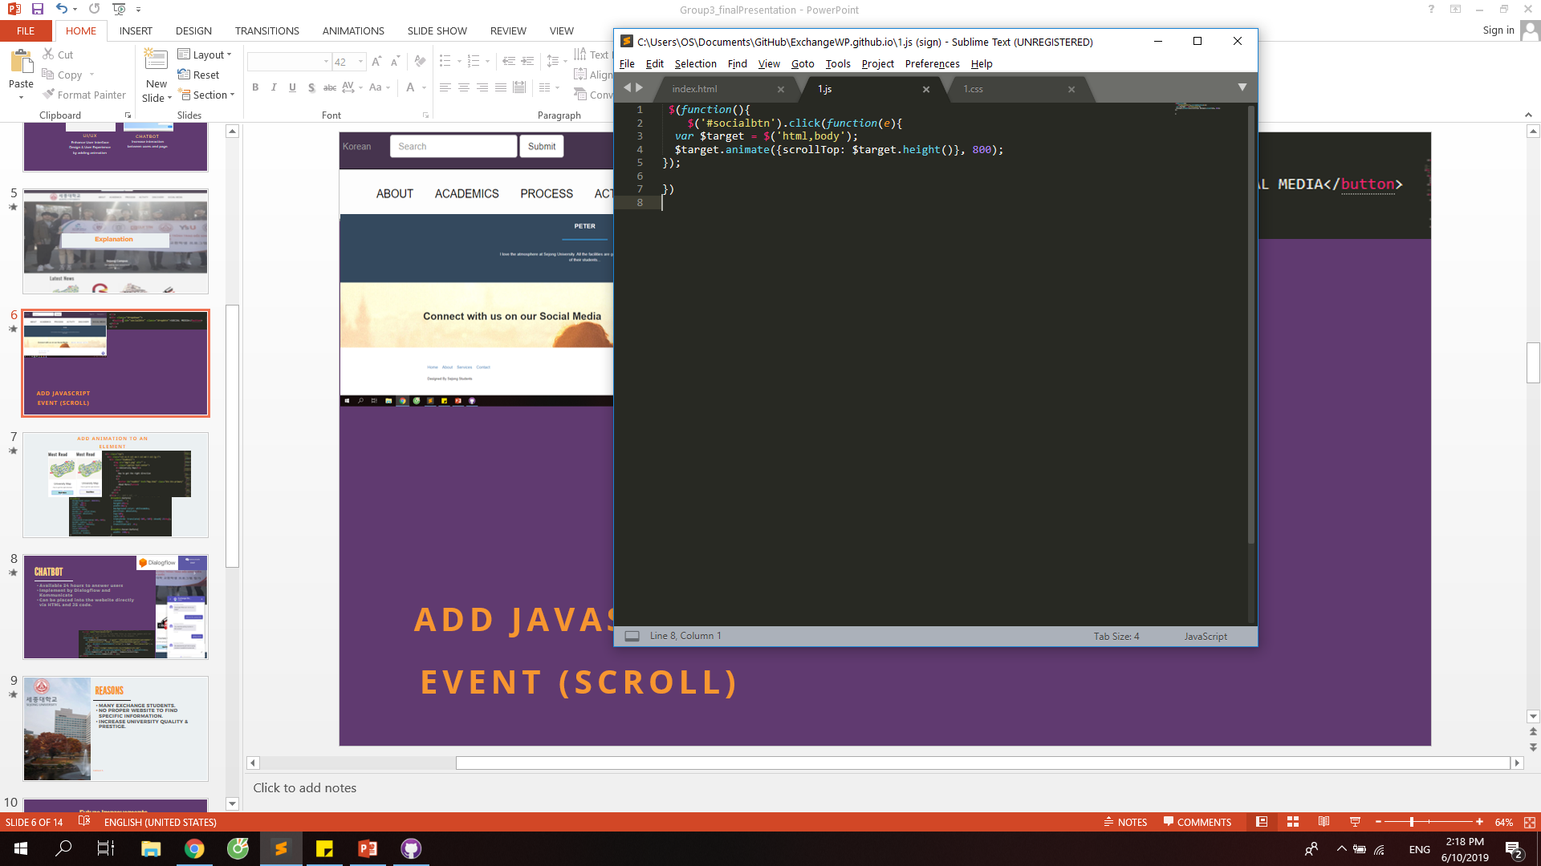
ADD JAVASCRIPT EVENT (SCROLL)

Slide 10
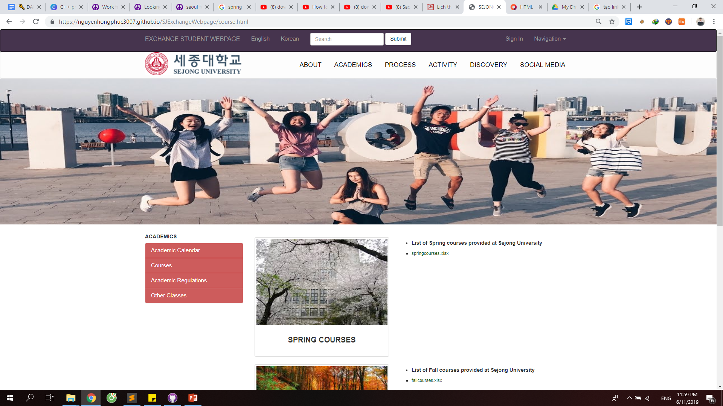
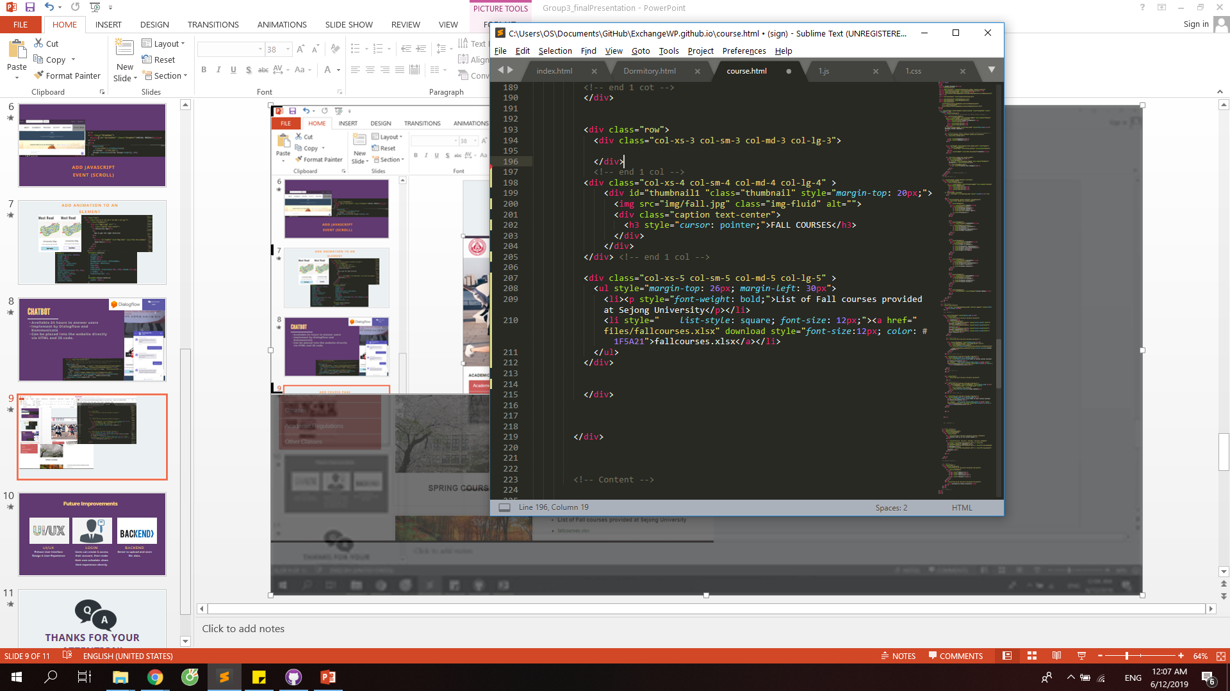
ADD COURSE PAGE

Slide 11



Future Improvements
UI/UX
LOGIN
BACKEND
Enhace User Interface Design & User Experience
Users can create & access their account, then make their own schedule, share their experience directly.
Server to upload and store file, data..

Slide 12

THANKS FOR YOUR ATTENTION!

